Slide 1
HOSTEL MANAGEMENT INFORMATION SYSTEM
BATCH 2021 - 5768
Enrollment Number | Name of the Student
EBEON0721407379 | M.TAMIL SELVAM
EBEON0721410266 | N.AJAYKARTHI
EBEON0721407387 | R.GOPALAKRISHNAN
EBEON0721405315 | D.NANDHINI
Under The Guidance of
E Santosh Mali (Java Trainer)

Slide 2
Abstract
The “HOSTEL MANAGEMENT SYSTEM” is an application developed for managing Various activities in the hostel. This project deals with the problems of managing a hostel and avoids the problems which occur when carried manually. This application is useful to avoid the manual data entry and is easy to access the data about the hostels. Thereby the management of hostel becomes easier to maintain and access. The application is provided with easily understandable and user friendly GUI.
The main objectives of the project are to reduce the human effort and processing Time in maintaining the student and staff information, accessing the data more easily. The various activities in the hostel management include the management of student data who are living in the hostels, calculating the mess bill per month, updating the grocery details daily in the hostel.

Slide 3
Introduction
“Hostel Management System” is a web application developed for managing various activities
in the hostel.
This project deals with the problems on managing a hostel
that are carried out by manual entry of hostel data.
It helps to know and manage
Student Details
Staff Details
Mess bill Information
Updating the grocery details in the hostels.

Slide 4
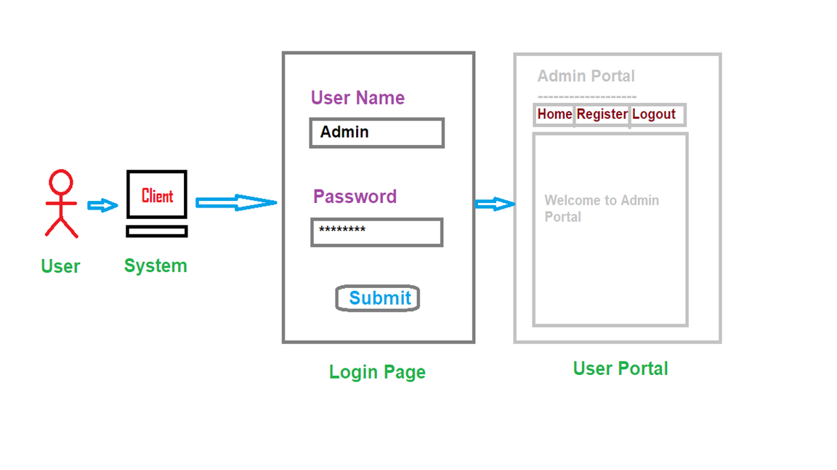
Overview

Slide 5
Goals and Objectives
The main goal of the project is to design an application which allows to easy to handle the data regarding the hostels.
Objectives of HOSTEL MANAGEMENT SYSTEM:
To maintain and manage the hostel information easily.
To avoid the complexity and to reduce time in data processing.
To provide data access through the users and students according to their roles and levels.

Slide 6

SYSTEM ANALYSIS
Existing System:
The existing system is a manually maintained system.
All the hostel records are to be maintained for the details of each student, fee details, contact information. All these details are entered and retrieved manually.
The existing system is
More time consuming process (For ex., searching for a record, registering a record etc.).
Update complexities.
Limited data availability.

Slide 7
Proposed System
The main advantages of the proposed system are-
Reduces the time as well as manpower
Easy data availability
Easy data accessibility
Easy data maintenance

Slide 8
Software Requirements :
Front-End : HTML, CSS, BOOTSTRAP, JavaScript
Back-End : Java
Database : MySQL
IDE : Eclipse

Slide 9
IMPLEMENTATION MODULE
This system mainly contains the following modules
ADMIN
WARDEN
CLERK
STUDENT COORDINATOR
STUDENT

Slide 10
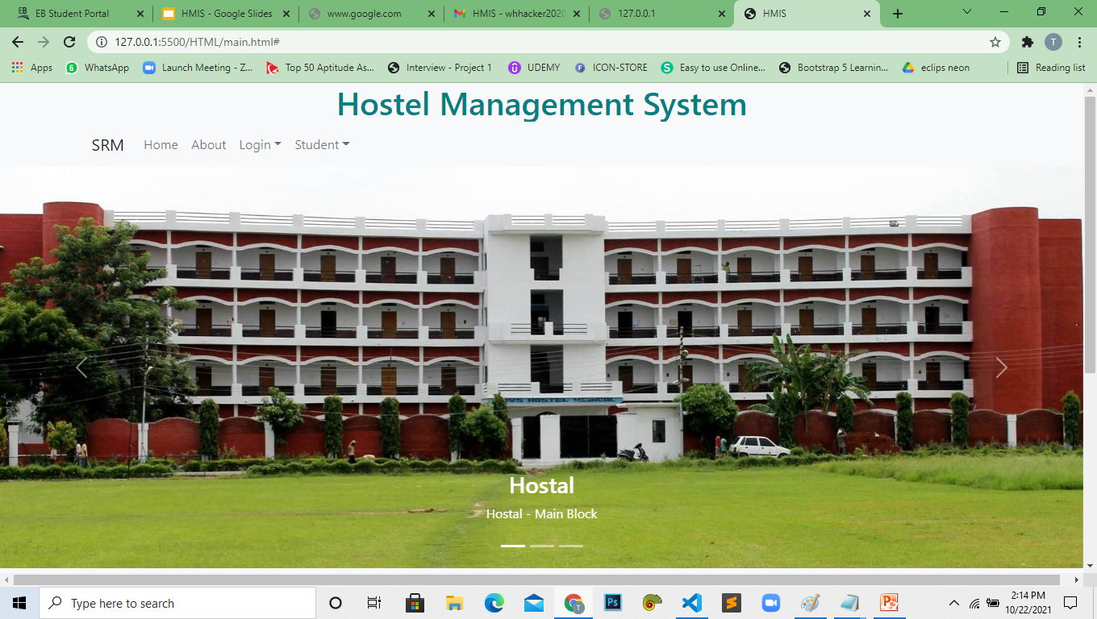
HOME :
=> This page was developed by Nandhini

Slide 11
ADMIN MODULE -
This Module was developed by TAMIL SELVAM
=> Warden Registration
=> Clerk Registration
=> Student Co-ordinator Registration
=> Information update

Slide 12
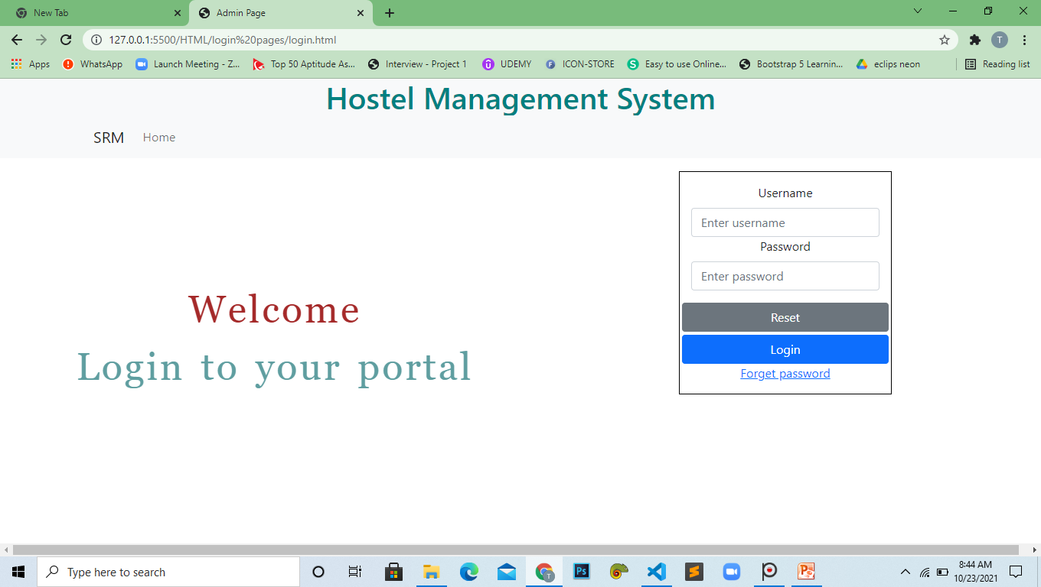
ADMIN :

Slide 13
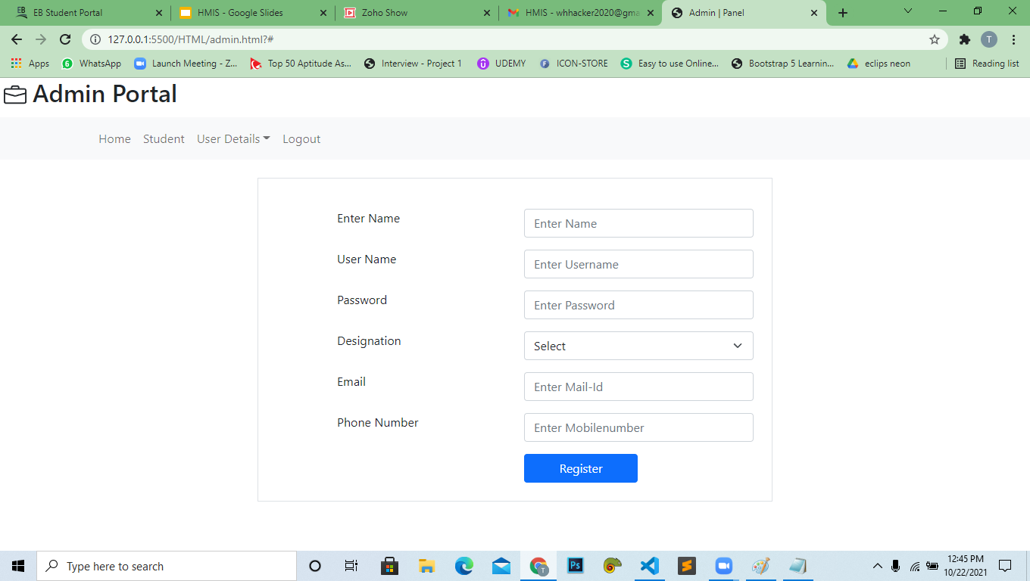

Slide 14
CLERK MODULE
This Module was developed by TAMIL SELVAM
=> Student Registration
=> Get Student Information
=> Student Mess bill Update
=> Information Updates

Slide 15
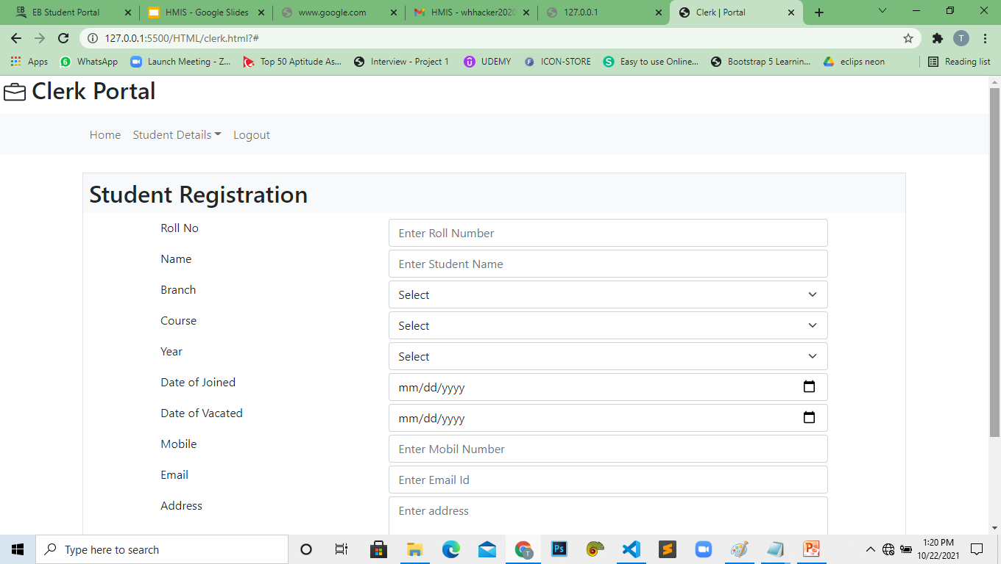
Clerk Module :

Slide 16
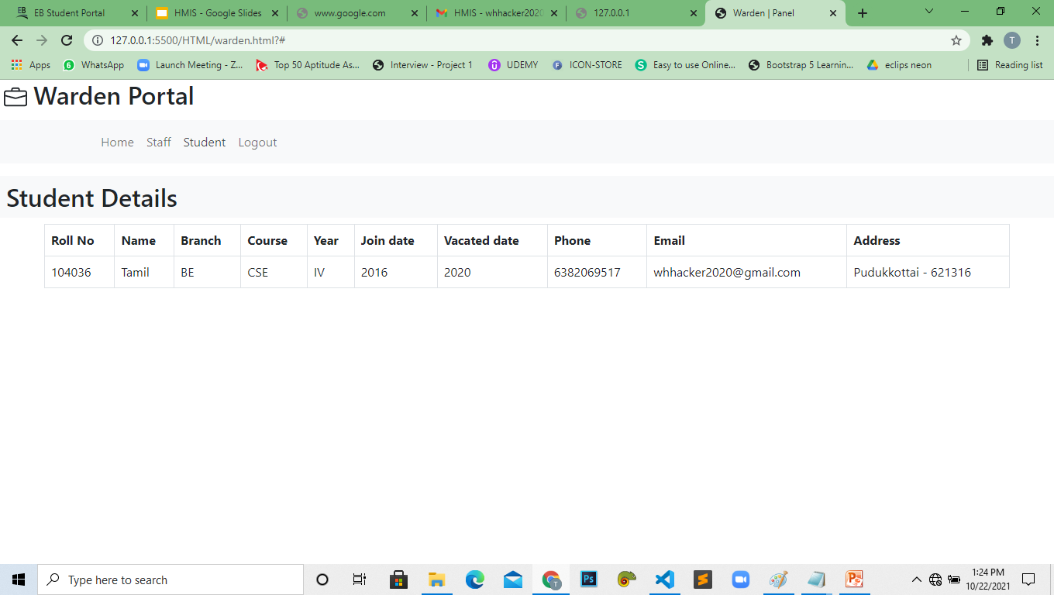
WARDEN MODULE -
This module was developed by Ajaykarthi
View Student Information
View Staff Information

Slide 17
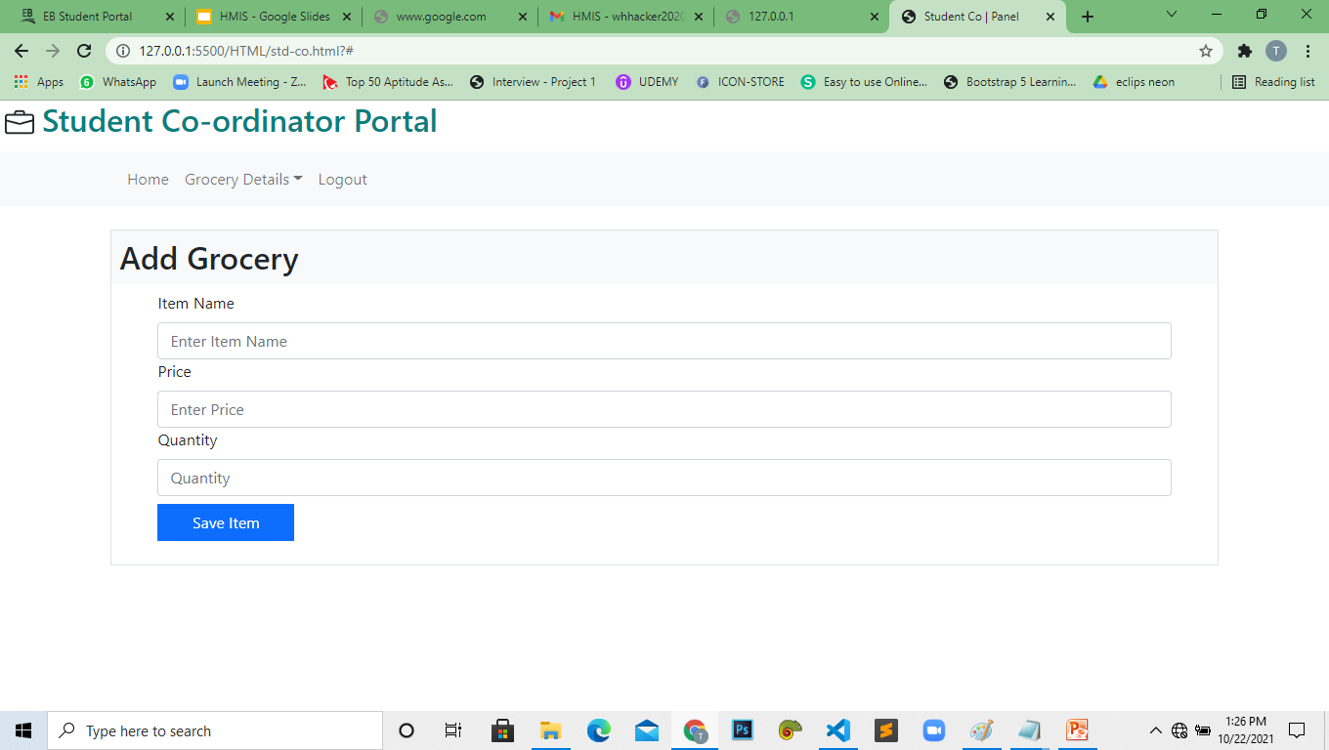
STUDENT CO-ORDINATOR MODULE
=> This Module was developed by GopalaKrishnan
=> View Hostel Mess Grocery Details
=> Update Hostel Mess Grocery Details

Slide 18
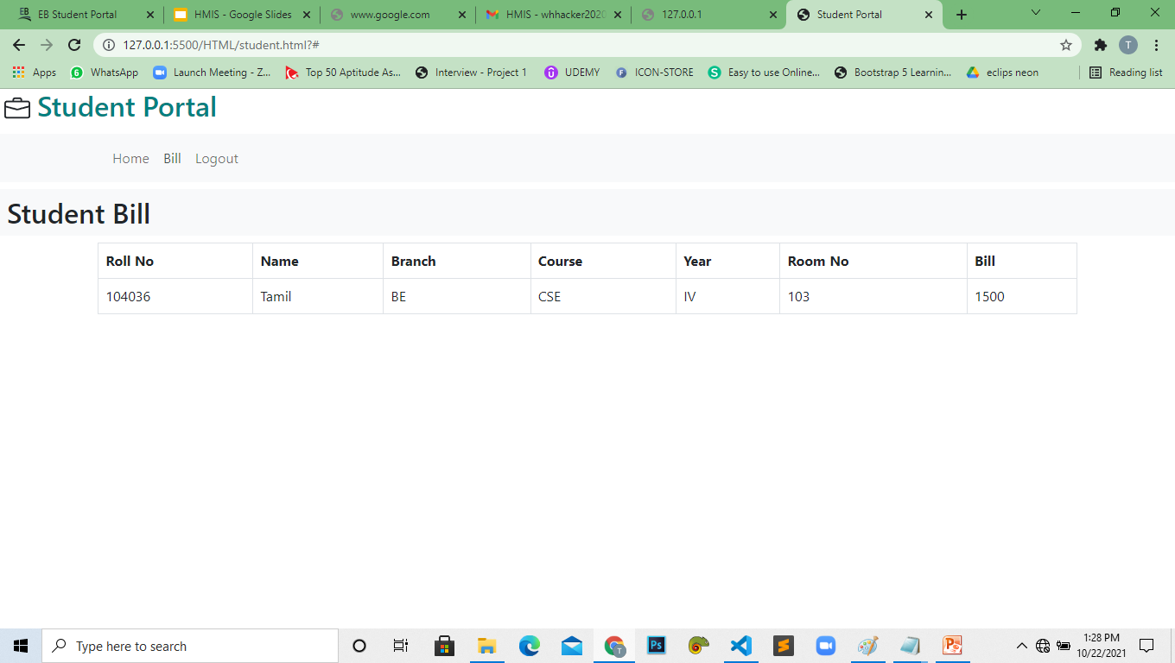
STUDENT MODULE –
=> This Module was developed by GopalaKrishnan
=> View Mess bill Information Details

Slide 19
Thank You

